Slide 1
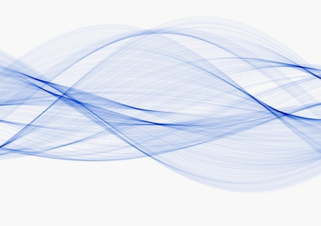
Wave Natures and Ray Transmission
Dr. Monir Morshed
Professor
Dept. of ICT, MBSTU

Slide 2
The Nature of Light
There are three theories explain the nature of light:
Quantum Theory – Light consists of small particles (photons). This theory better explains light detection and generation processes.
Wave Theory – Light travels as a transverse electromagnetic wave.
Ray Theory – Light travels along a straight line and obeys laws of geometrical optics – useful tool when the objects are much larger than the wavelength of light

Slide 3
The dual nature of light
Scientists have observed that light energy can behave
like a wave as it moves through space, or it can behave like a discrete particle with a discrete amount
of energy (quantum) that can be absorbed and emitted. As we study and use light, both models are helpful. Two models are:
Quantum Theory of Light
Wave Theory of Light

Slide 4
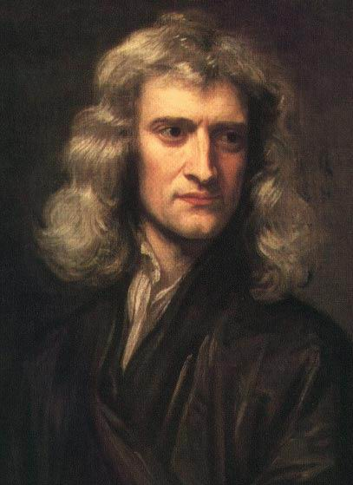
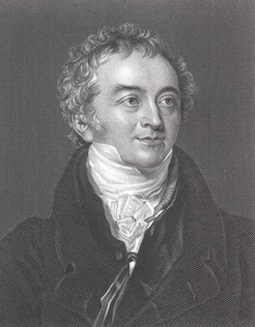
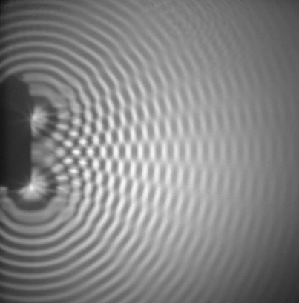
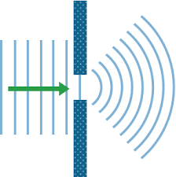
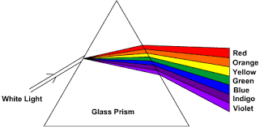
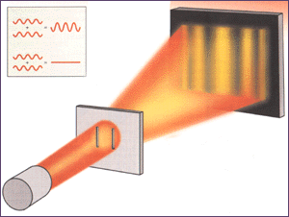
Wave Nature of Light
Newton (1680) believed in the particle theory of light. In reflection and refraction, light behaved as a particle. He explained the straight-line casting of sharp shadows of objects placed in a light beam. But he could not explain the textures of shadows
Interference
Diffraction
Young (1800) – Showed that light interfered with itself. Wave theory: Explains interference, diffraction, and dispersion.
The wave theory is also able to account for the fact that the edges of a shadow are not quite sharp.
This theory describes: Propagation, reflection, refraction and attenuation
Dispersion
G Ekspong, Stockholm University, Sweden, 1999.

Slide 5
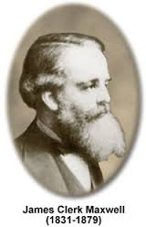
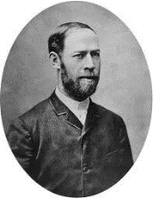
Wave Nature of Light - contd.
James Clerk Maxwell (1850) - Mathematical theory of electromagnetism led to the view that light is of electromagnetic nature, propagating as a wave from the source to the receiver.
Heinrich Hertz (1887) - Discovered experimentally the existence of electromagnetic waves at radio-frequencies.
Wave theory does not describe the absorption of light by a
photosensitive materials
He discovered the photoelectric effect. So what is it?

Slide 6
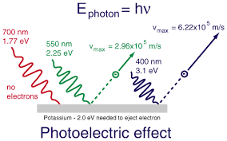
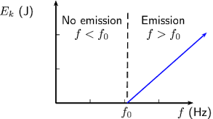
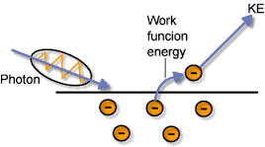
Wave Nature of Light - contd.
Light (electromagnetic wave) shining on a metal surface results in its energy being transferred to the electrons on the surface of the metal and some electron will escape. The released electron are called “photo-electron”.
E_{photo-electron} is related to the f_{incident} light but not its intensity. So light is energetic enough to shift electron(s) or not.
The work function – The amount of E need by EM wave to free an electron from a meta surface (i.e., a E_{threshold}).
1900-20 Max Planck, Neils Bohr and Albert Einstein
Invoked the idea of light being emitted in tiny pulses of energy

Slide 7
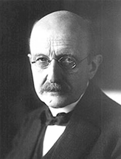
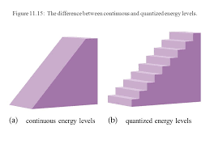
Wave Nature of Light - contd.
Planck (1900) - Developed a model that explained light as a quantization of energy [Got a Nobel Prize]. Considered the Block Body cavity -
E = nhf n = 0, 1, 2, 3.., h = Plancks’ constant 6.626 x 10⁻³⁴ JS [or 4.136 x 10⁻¹⁵ eVs] , f = frequency of one of the standing wave within a black body.
- The energy spectrum of the standing wave within the black body cavity is not continuous as in the classical theory, but take specific values:
Classical Quantum
E.g., - A standing wave within a black body cavity has a frequency f = 7.25 x 10¹⁴ Hz (Blue-violet).
The energy is:
E = n(4.136 x 10⁻¹⁵ eVs)(7.25 x 10¹⁴ Hz) = n(3 eV),
So for n = 1, 2, 3, 4, .. we have E = 3, 6, 9, 12, …. But not 1, 2, 4, 5, 7, 8 and so on.
Interesting!
This contradicted the continuous wave theory of light, where wave DO NOT have distinct constituent!
Energy

Slide 8
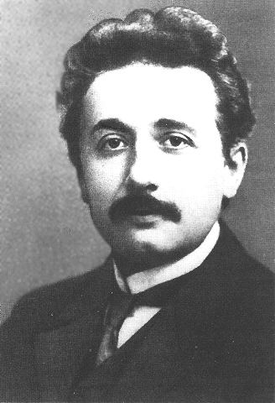
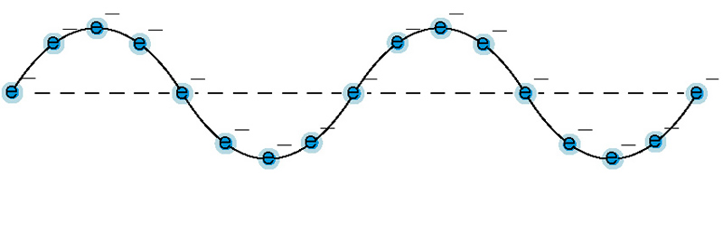
Wave Nature of Light - contd.
Einstein (1905) – Used Plank’s idea to showed that in the photoelectric effect (light causing electrons to be emitted from a metal surface) light must act as a particle.
Therefore, light must be regarded as having a dual nature;
in some cases light acts as a wave
in others it acts like a particle.
He came up with this
K_{max} = hf - φ
Max. kenetic
Energy of an
electron
Work
function

Slide 9
Wave Theory of Light
Electromagnetic light signal has electric and magnetic fields orthogonal to each other.
The frequency of this EM wave is in the order of THz. Therefore, it is convenient to measure it in terms of wavelength.
where, c - speed of light 3 X 10⁸ m/s in air, ν - frequency and λ- wavelength
Ex: Find the ν when λ = 1550 nm.
Answer: 193.5 THz

Slide 10
Particle Nature of Light
Light behaviour can be explained in terms of the amount of energy
imparted in an interaction with some other medium. In this case, a
beam of light is composed of a stream of small lumps or QUANTA of
energy, known as PHOTONS. Each photon carries with it a precisely
defined amount of energy defined as:
W_{p} = h*f Joules (J)
where; h = Plank's constant = 6.626 x 10⁻³⁴ J.s, f = Frequency Hz
The convenient unit of energy is electron volt (eV), which is the kinetic energy acquired by an electron when accelerated to 1 eV = 1.6 x 10⁻¹⁹ J.
Even although a photon can be thought of as a particle of energy it still has a
fundamental wavelength, which is equivalent to that of the propagating wave as
described by the wave model.
This model of light is useful when the light source contains only a few photons.

Slide 11
Particle Theory Vs. Wave Theory
Newton’s particle theory explain Only four properties of light:
rectilinear propagation,
reflection,
refraction,
and dispersion.
Wave theory (Huygens’ wave theory.) of light explains most phenomena involving light:
propagation in straight line
reflection
refraction
superposition, interference, diffraction
polarization
Doppler effect

Slide 12
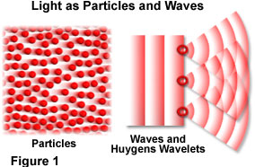
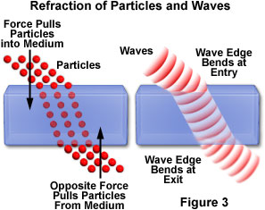
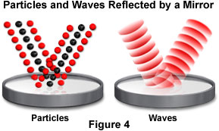
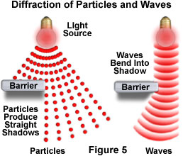
Light: Particle or a Wave?

Slide 13
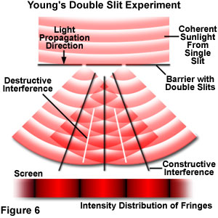
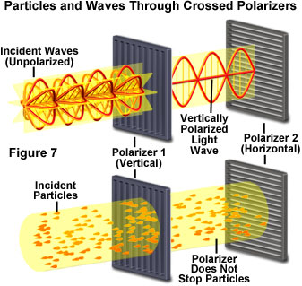
Light: Particle or a Wave?(continue)

Slide 14
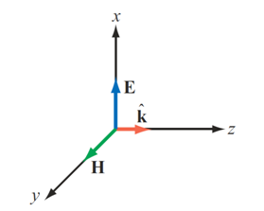

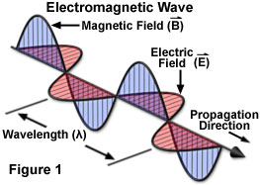

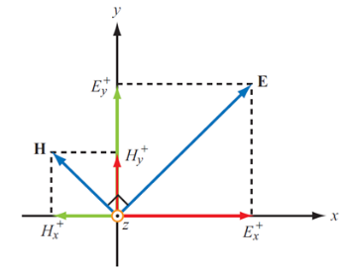
Electromagnetic Radiation
Carries energy through space (includes visible light, dental x-rays, radio waves, heat radiation from a fireplace)
The wave is composed of a combination of mutually perpendicular electric and magnetic fields the direction of propagation of the wave is at right angles to both field directions, this is known as an
ELECTROMAGNETIC WAVE
EM wave move through a vacuum at 3.0 x 10⁸ m/s ("speed of light")
E = v_{p}H = H [c/n]
Speed of light in a vacuum
β - Propagation constant = ω/v_{p}
The optical field generally refers to the electric field.

Slide 15
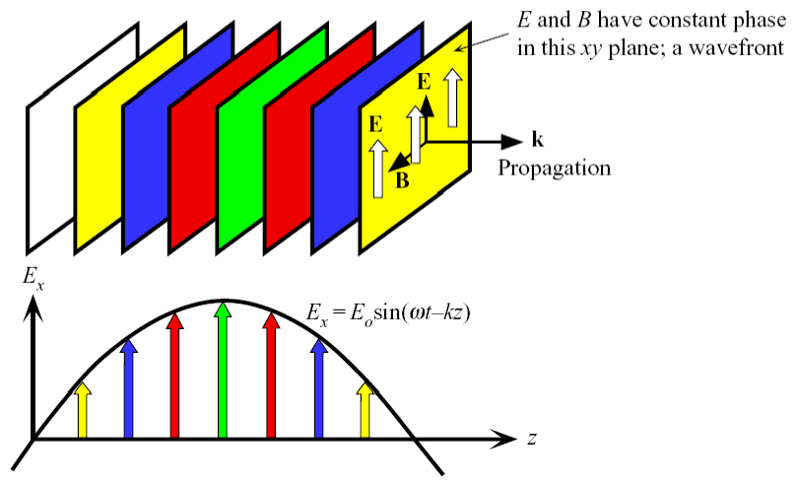
Plane Electromagnetic Wave
A surface over which the phase of a wave is constant is referred to as a
wavefront.

Slide 16
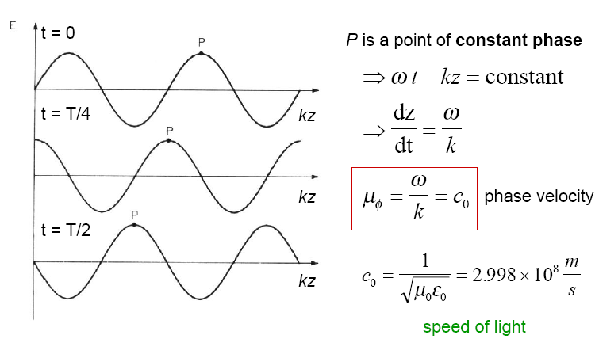
Phase Velocity
The phase velocity of a wave is the rate at which the wave propagates in any medium.
v_{p}
c_{o}: Speed of light in air
n: Refractive index
Phase velocity:

Slide 17
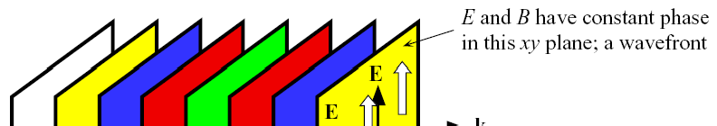
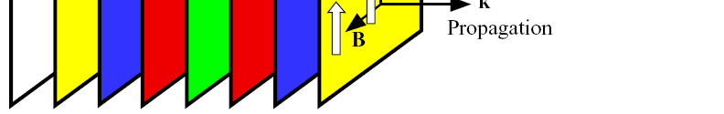

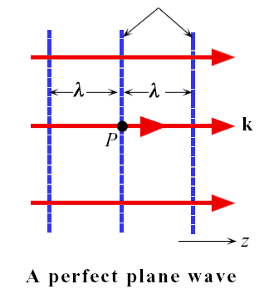
Plane Waves
E_{x} = E₀ cos(ωt − kz + φ₀)
The plane wave has no angular separation (no divergence) in its wavevectors.
E₀ does not depend on the distance from a reference point, and it is the same at all points on a given plane perpendicular to k.
The plane wave is an idealization that is useful in analyzing many wave phenomena.
Real light beams would have finite cross sections.
The plane wave obeys Maxwell’s EM wave equations.

Slide 18
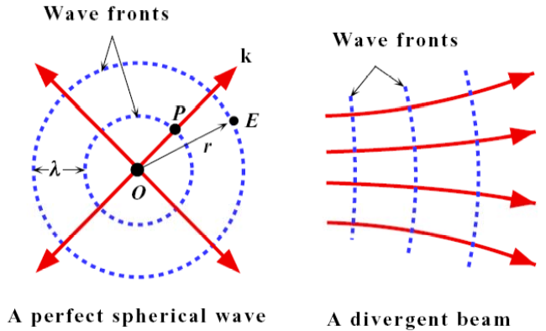
Diverging Waves
∂² E ∂² E ∂² E
∂² E
+ +
= ε ε μ
∂x² ∂y² ∂z ²
0 r 0
∂t ²
E = (A/r) cos(ωt − kr)
A spherical wave is described by a traveling wave that emerges from a point EM source and whose amplitude decays with the distance r from the source.
Optical divergence refers to the angular separation of wavevectors on a given wavefront.
Plane and spherical waves represent two extremes of wave propagation behavior from perfectly parallel to fully diverging wavevectors. They are produced by two extreme sizes of EM wave sources: an infinitely large source for the plane wave and a point source for the spherical wave. A real EM source would have a finite size and finite power.

Slide 19
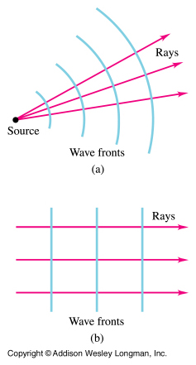
The Wave Equation
Solutions to Maxwell’s equations:
phase fronts
λ
λ
Plane wave:
Spherical wave:
Wave number in vacuum
Note: k = β

Slide 20
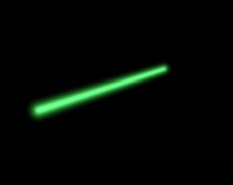

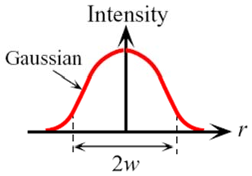
Gaussian Beams
Many laser beams can be described by Gaussian beams.
A Gaussian beam has an exp[j(ωt − kz)] dependence to describe propagation characteristics but the amplitude varies spatially away from the beam axis.
The beam diameter 2w at any point z is defined as the diameter at which the beam intensity has fallen to 1/e² (13.5%) of its maximum.

Slide 21
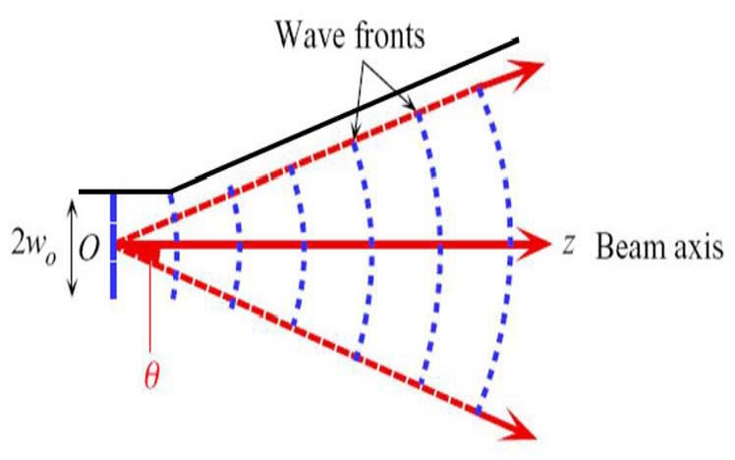
Gaussian Beams
Diffraction causes light waves to spread transversely as they propagate, and it is therefore impossible to have a perfectly collimated beam. The spreading of a laser beam is in precise accord with the predictions of pure diffraction theory. Even if a Gaussian laser beam wavefront were made perfectly flat at some plane, it would quickly acquire curvature and begin spreading out. The finite width 2w₀ where the wavefronts are parallel is called the waist of the beam. w₀ is the waist radius and 2w₀ is the spot size. The increase in beam diameter 2w with z makes an angle of 2θ, which is called the beam divergence. The spot size and beam divergence are two important parameters when choosing lasers.

Slide 22
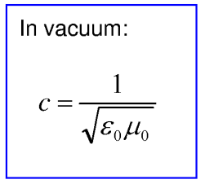
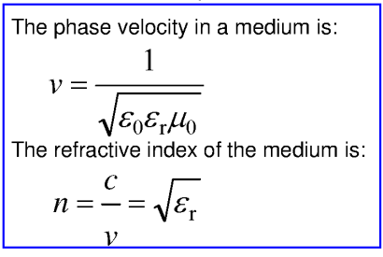
Refractive Index
A refractive index of a material defines that how fast light travels through the material.
Material | Index of refraction
Air | 1.0
Carbon dioxide | 1.0
Water | 1.33
Ethyl alcohol | 1.36
Magnesium fluoride | 1.38
Fused silica | 1.46
Polymethyl methacrylate | 1.49
Silica glass | 1.5
Sodium chloride | 1.54
Polystyrene | 1.59
Calcite | 1.6
Silicon | 3.5
Gallium arsenide | 3.35
Indium gallium arsenide | 3.6

Slide 23
Group Velocity
Since there are no perfect monochromatic waves in practice, we have to consider the way in which a group of waves differing slightly in wavelength travel along the same direction. For two harmonic waves of frequencies ω − δω and ω + δω and wavevectors k − δk and k + δk interfering with each other and traveling along the z direction:
E_{x,1} (z, t ) = E₀ cos[(ω − δω)t − (k − δk )z]
E_{x,2} (z, t ) = E₀ cos[(ω + δω)t − (k + δk )z]
Using

Slide 24
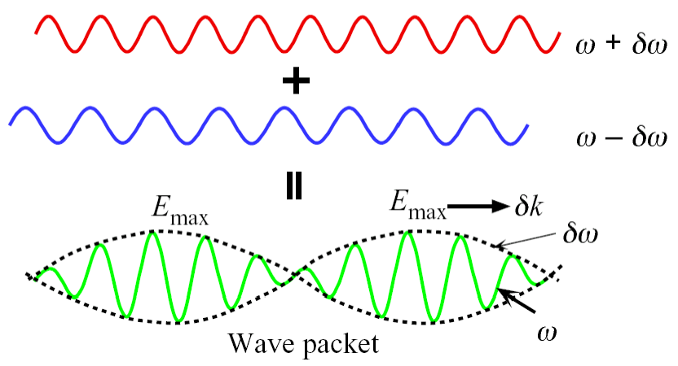
Group Velocity
We obtain:
E_{x}
= 2E₀ cos[(δω )t − (δk )z]cos(ωt − kz)
^{= E}x,1 ^{+ E}x,2
Generate a wave packet containing an oscillating field at the mean frequency ω with the amplitude modulated by a slowly varying field of frequency δ .

Slide 25
E_{x}  2E₀ cost  k zcost  kz
Group Velocity
The maximum amplitude moves with a wavevector
Phase velocity v = ^{ω} = ^{c}
k n
δk and a frequency δω.
In vacuum:
dω
Group velocity
v_{g} =
ω = ck
dk
dω
v_{g} =
= c
The group velocity defines the speed with which energy or information is propagated
dk
group velocity
since it defines the speed of the envelope of the amplitude variation.
phase velocity

Slide 26
In a medium with n as a function of λ₀:
dω
c c
dn
v_{g} = = =
N_{g} = n − λ₀
dk
dn
N_{g}
n − λ₀
dλ₀
dλ₀
N_{g} is the group index of the medium.
ck = n
dk cdk d (ck )
d (nω ) 1 ⎛
dn ⎞
=
=
=
= ⎜ n + ω
⎟
dω cdω cdω cdω c ⎝
dω ⎠
2πc
λ₀ ₌
ω

Slide 27
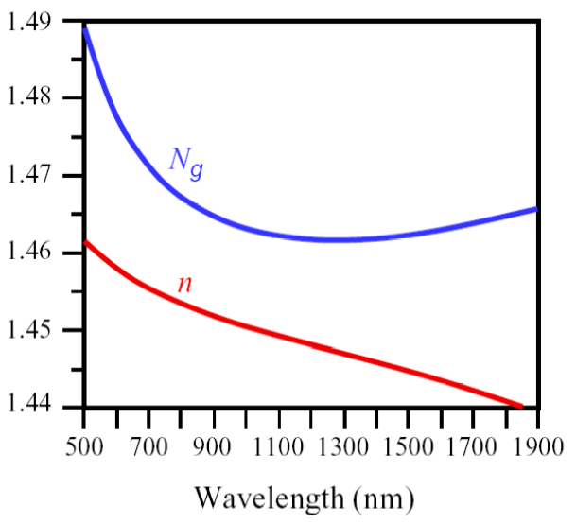
Group Index of the Medium
Pure SiO₂
For silica, N_{g} is minimum around 1300 nm, which means that light waves with wavelengths close to 1300 nm travel with the same group velocity and do not experience dispersion.
Both n and N_{g} are functions of the free space wavelength. Such a medium is called a dispersive medium. n and N_{g} of SiO₂ are important parameters for optical fiber design in optical communications.

Slide 28
Ray Transmission Theory

Slide 29
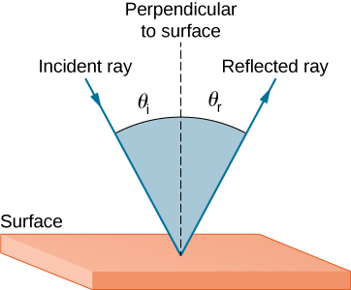
Ray optics: basic laws
Ray optics is based on three laws which describe the propagation of rays:
Light rays in homogeneous media are straight lines.
Law of reflection: Reflection in a mirror or at the boundary between two media of different refractive indices: the reflected ray lies in the plan of incidence, the angle of reflection equals the angle of incidence (i.e. θ_{r} = θ_{i})

Slide 30
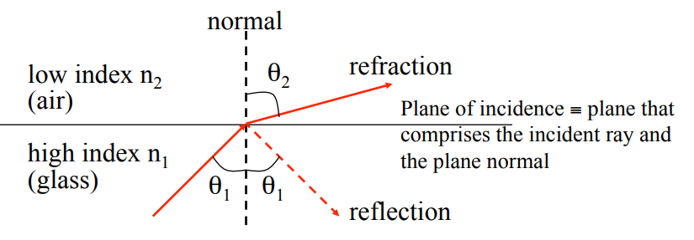
Snell’s law
At the boundary between two media of different refractive indices n, the reflected ray lies in the plane of incidence. The angle of refraction θ_{t} is related to the angle of incidence θ_{i} by
n_{i} sinθ_{i} = n_{t} sinθ_{t} .
When a ray is incident on the interface between two dielectrics of different refractive indices (e.g. glass-air), reflection and refraction occur.
The snells law of refraction: n₁ sinθ₁ = n₂ sinθ₂ .

Slide 31
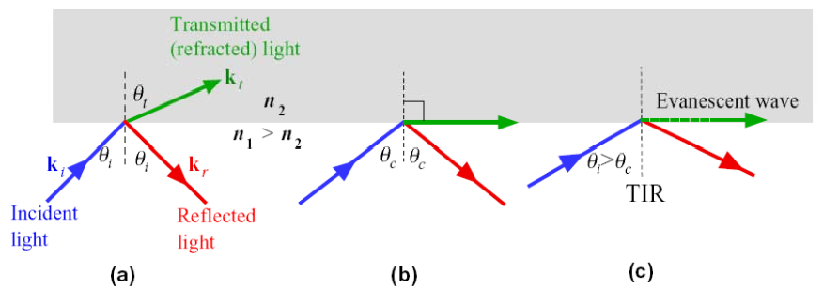
Refraction
Total Internal Reflection
When n₁ > n₂ and θ_{t} = 90°, the incidence angle is called the critical angle θ_{c}:
n
sinθ_{c} =
2
n₁

Slide 32
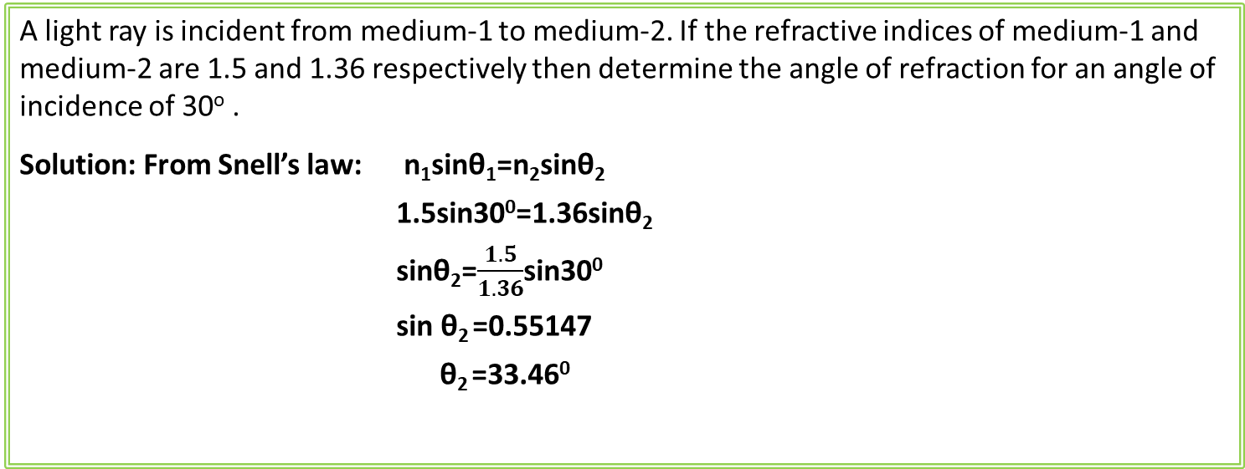
Refraction
A light ray is incident from medium-1 to medium-2. If the refractive indices of medium-1 and medium-2 are 1.5 and 1.36 respectively then determine the angle of refraction for an angle of incidence of 30º .
Solution: From Snell’s law: n₁sinθ₁=n₂sinθ₂
1.5sin30⁰=1.36sinθ₂
sinθ₂=$\frac{1.5}{1.36}$sin30⁰
sin θ₂ =0.55147
θ₂ =33.46⁰
A light ray is incident from glass to air. Calculate the critical angle (θ_{c} ).

Slide 33
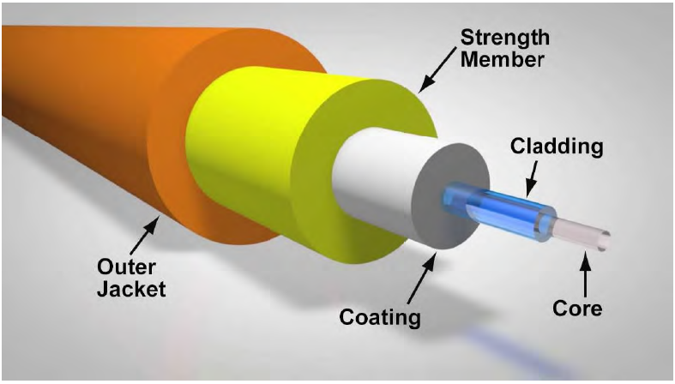
Optical fiber structures
Core: The inner light-carrying layer with a high index of refraction. The core diameter can vary from about 5 μm to 100 μm.
Cladding: The middle layer, which serves to confine the light to the core. It has a lower refraction index than the core.
Jacket/Buffer: The outer layer, which serves as a "shock absorber" to protect the core and cladding from damage. The coating usually comprises one or more coats of a plastic material to protect the fiber from the physical environment. Sometimes metallic sheaths are added to the coating for further physical protection. The typical diameter of fiber after coating is 250 μm to 300 μm.

Slide 34
Working Principle of Fiber
n₂
Coating
Cladding
Core
n₁
Air
n₂
n₂
n₁>n₂
Cladding
n₁
θ₁
θ₁>θ_{c}
Core
n₁
When an ray of light travels from a denser (high index) to a rarer (low index) medium such that the angle of incidence is greater than the critical angle, the ray reflects back into the same medium.
In the optical fiber the rays undergo repeated total number of reflections until emerges out of the other end of the fiber, even if fiber is bend.

Slide 35
Light ray guiding condition
Air
n₂
n₂
n₁>n₂
Cladding
n₁
θ₁
θ₁>θ_{c}
Core
n₁
The refractive index of a core is n₁ = 1.46, and cladding n₂ = 1.44. Under what conditions will light be trapped inside the core?
Solution:
θ_{c} = sin⁻¹ (n₂/n₁) = sin⁻¹ (1.44/1.46) = 80.5º
If θ_{i}> θ_{c}, the light will be trapped inside the core.

Slide 36
Silica optical fibers
Both the core and the cladding are made from a type of glass known as silica (SiO2) which is almost transparent in the visible and near-IR.
The higher core refractive index (~ 0.3% higher) is typically obtained by doping the silica core with germanium dioxide (GeO2).

Slide 37
In Lab1, we shall learn how to strip off the jacket to expose the cladding. This is necessary in order to “cleave” the fiber for a smooth end face for light coupling.
In Lab 1, we should be able to see the step boundary between the core and the cladding, by end-illuminating the fiber and imaging the output-end cross-section using a microscope.

Slide 38
Numerical aperture
An important characteristic of an optic system is its ability to collect light incident over a wide range of angles.
f
f
θ
The numerical aperture (NA) is defined as:
NA = n_{o} sin θ
where n_{o} is the refractive index of the medium between the lens and the image plane (e.g. a photodetector) and θ is the maximum acceptance angle.

Slide 39
Numerical aperture
The definition of numerical aperture applies to all light-collecting systems, including optical fibers.
e.g. Light rays incident at angles outside the collection cone for a fiber will not propagate along the fiber (instead will attenuate rapidly).
The numerical aperture is often measured in air, n_{o} = 1
NA = sin θ
A low NA indicates a small acceptance angle.
Light coupling to a low-NA optical system (e.g. fiber) is more difficult (alignment is more sensitive) and less efficient (some of the rays are outside the acceptance angle) than is coupling to a high-NA optical system.

Slide 40
Acceptance angle
Only rays with a sufficiently shallow grazing angle (i.e. with an angle to the normal greater than θ_{c}) at the core-cladding interface are transmitted by total internal reflection.
α_{c}
θ_{c}
θ
n
a
1
A
n_{a}
n₂
θ < θ_{a}
α_{c}
θ_{c}
θ_{a}
n
1
n_{a}
n₂
θ > θ_{a}
α_{c}
θ_{c}
θ
n
a
1
n_{a}
n₂
Light rays will be confined inside the fiber core if it is input-coupled at the fiber core end-face within the acceptance angle θ_{a}.

Slide 41
Acceptance angle
α_{c}
θ_{c}
θ
n
a
1
A
n_{a}
n₂
e.g. What is the fiber acceptance angle when n₁=1.46 and n₂ = 1.44?
θ_{c} = sin⁻¹ (n₂/n₁)=80.5º => α_{c} = 90º - θ_{c}= 9.5º using, sin θ_{a} = n₁ sin α_{c} (taking n_{a} = 1)
θ_{a} = sin⁻¹ (n₁ sin α_{c}) =sin⁻¹ (1.46 sin 9.5º)~14º
=>the acceptance angle θ_{a}~14º

Slide 42
Fiber numerical aperture
In fiber optics, we describe the fiber acceptance angle using
Numerical Aperture (NA):
NA = n_{a} sin θ_{a} = sin θ_{a} = (n₁ ² – n₂ ²)^{1/2}
α_{c}
θ_{c}
θ
n
a
1
n_{a}
n₂
we consider the refraction at the air-core interface using Snell’s law:
At θ_{a}: n_{a} sin θ_{a}=n₁ sin α_{c}
launching the light from air (n_{a} ~ 1):
sin θ_{a} =n₁ sin α_{c}
= n₁ cos θ_{c}
= n₁ (1 - sin²θ_{c})^{1/2}
= n₁ (1 - n₂²/n₁²)^{1/2}
= (n₁²- n₂² )
e.g. What is the fiber numerical aperture when n₁ = 1.46 and n₂= 1.44?
NA = sin θ_{a} = (1.46² - 1.44²)^{1/2} = 0.24
It is a common practice to define a relative refractive index Δ as:
Δ= (n₁ - n₂) / n₁
NA=n₁(2Δ)^{1/2} if n₁∼n₂

Slide 43
Lens coupling to fiber end faces
Microscope objective lens
collimated laser beam
θ_{a}
few mm focal length
θ_{a}
focusing objective lens
θ_{a}
“fiber under test”
collecting objective lens
By measuring the output couple ray cone angle, we can measure the fiber acceptance angle.

Slide 44
Large-NA fibers?
Developing ways for fiber to collect light efficiently was an important early step in developing practical fiber optic communications (particularly in the 1970s).
It seems logical to have optical fibers with NA as large as possible … with as large Δ as possible … in order to couple maximum amount of light into the fiber.
Soon, we will find out that such large-NA fibers tend to be “multimode” and are unsuitable for high-speed communications because of a limitation known as modal dispersion.
Relatively small-NA fibers are therefore used for high-speed optical communication systems.

Slide 45
Typical fiber NA
Silica fibers for long-haul transmission are designed to have numerical apertures from about 0.1 to 0.3.
The low NA makes coupling efficiency tend to be poor, but turns out to improve the fiber’s bandwidth! (details later)
Plastic, rather than glass, fibers are available for short-haul communications (e.g. within an automobile). These fibers are restricted to short lengths because of the relatively high attenuation in plastic materials.
Plastic optical fibers (POFs) are designed to have high numerical apertures (typically, 0.4 – 0.5) to improve coupling efficiency, and so partially offset the high propagation losses and also enable alignment tolerance.

Slide 46
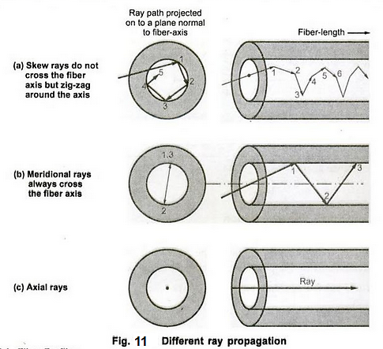
Types of Ray
Ray is an ideal narrow beam of light that is used to model the propagation of light through an optical system.

Slide 47
Limitation of ray optics
For smaller fiber diameters that are only few times of the wavelength, geometrical optics approach becomes inadequate. This is because ray optics only describes the direction a plane wave component takes in the fiber, but does not take into account interference among such components.
When interference phenomena are considered it is found that only rays with certain discrete characteristics propagate in the fiber core.
Thus the fiber will only support a discrete number of guided modes.
This becomes critical in small core diameter fibers which only support one (singlemode) or a few modes (multimode). Electromagnetic theory must be applied in this case.

